Slide 1
Chapter 3
MONEY MARKETS

Slide 2
Chapter Preview (Self study)
The Money Markets Defined
The Purpose of Money Markets
Who Participates in Money Markets?
Money Market Instruments
Comparing Money Market Securities
Ref: Mishkin & Eakins, Financial Markets + Institutions, Ch11

Slide 3
The Money Markets
Money market securities are usually sold in large denominations ($1,000,000 or more)
They have low default risk
They mature in one year or less from their issue date
Money (currency) is not actually traded in the money markets. The securities in the money market are short term with high liquidity; therefore, they are close to being money.

Slide 4
Why Do We Need Money Markets?
The banking industry should handle the needs for short-term loans and accept short-term deposits. Banks also have an information advantage on the credit-worthiness of participants.
Banks do mediate between savers and borrowers; however, they are heavily regulated. This creates a distinct cost advantage for money markets over banks.

Slide 5
The Money Markets Defined: Cost Advantages
Reserve requirements create additional expense for banks that money markets do not have
Regulations on the level of interest banks could offer depositors lead to a significant growth in money markets, especially in the 1970s and 1980s. When interest rates rose, depositors moved their money from banks to money markets to earn a higher interest rate.

Slide 6
3-month T-bill rates and Interest Rate Ceilings

Slide 7
The Purpose of Money Markets
Investors in Money Market: Provides a place for warehousing surplus funds for short periods of time.
Borrowers from money market provide low-cost source of temporary funds.
Corporations and U.S. government use these markets because the timing of cash inflows and outflows are not well synchronized. Money markets provide a way to solve these cash-timing problems.

Slide 8
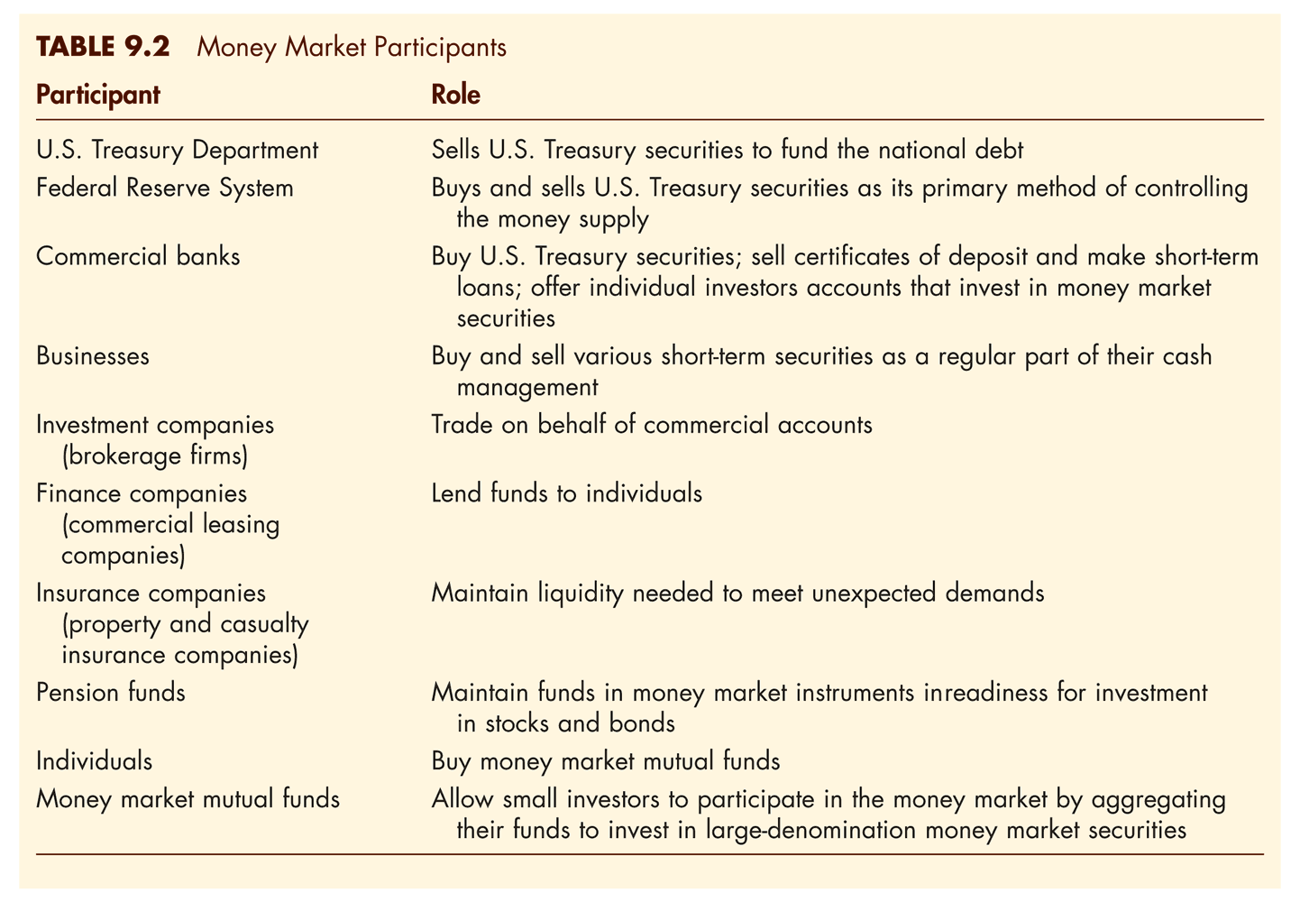
Who Participates in the Money Markets?

Slide 9
Who Participates in the Money Markets?

Slide 10
Money Market Instruments
Treasury Bills
Federal Funds
Repurchase Agreements
Negotiable Certificates of Deposit
Commercial Paper
Banker’s Acceptance
Eurodollars

Slide 11
Money Market Instruments: Treasury Bills
T-bills have 28-day maturities through 12- month maturities.
Discounting: When an investor pays less for the security than it will be worth when it matures, and the increase in price provides a return.

Slide 12
Money Market Instruments: Treasury Bills Discounting Example
You pay $996.37 for a 28-day T-bill. It is worth $1,000 at maturity. What is its discount rate?
(1)

Slide 13
Money Market Instruments: Treasury Bills Discounting Example
You pay $996.37 for a 28-day T-bill. It is worth $1,000 at maturity. What is its annualized yield?
(1)

Slide 14
Money Market Instruments: Treasury Bill Auctions
T-bills are auctioned to the dealers every Thursday.
The Treasury may accept both competitive and noncompetitive bids, and the price everyone pays is the highest yield paid to any accepted bid.

Slide 15
Money Market Instruments: Treasury Bill Auctions Example
The Treasury auctioned $2.5 billion par value 91-day T-bills, the following bids were received:
Bidder Bid Amount Bid Price
1 $500 million $0.9940
2 $750 million $0.9901
3 $1.5 billion $0.9925
4 $1 billion $0.9936
5 $600 million $0.9939
The Treasury also received $750 million in noncompetitive bids. Who will receive T-bills, what quantity, and at what price?

Slide 16
Money Market Instruments: Treasury Bill Auctions Example
The Treasury accepts the following bids:
Bidder Bid Amount Bid Price
1 $500 million $0.9940
5 $600 million $0.9939
4 $650 million $0.9936
Both the competitive and noncompetitive bidders pay the highest yield – based on the price of 0.9936:

Slide 17
Money Market Instruments: Treasury Bills

Slide 18
Fed Funds
Short-term funds transferred (loaned or borrowed) between financial institutions, usually for a period of one day.
Used by banks to meet short-term needs to meet reserve requirements.

Slide 19
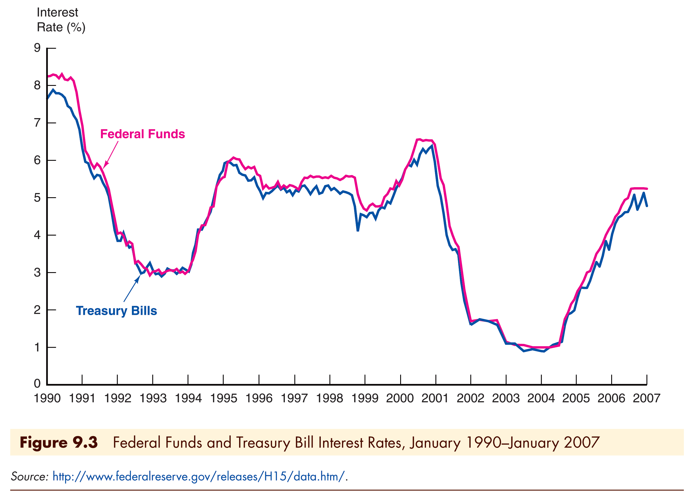
Fed Funds Rates

Slide 20
Repurchase Agreements
These work similar to the market for fed funds, but nonbanks can participate.
A firm sells Treasury securities but agrees to buy them back at a certain date (usually 3–14 days later) for a certain price.
This set-up makes a repo agreements essentially a short-term collateralized loan.
This is one market the Fed may use to conduct its monetary policy, whereby the Fed purchases/sells Treasury securities in the repo market.
Notes:
Kim Oanh sold real estate projects to THP as colleterals (value increases) after that THP refuses to sell to KO again as the agreement has mentioned

Slide 21
Negotiable Certificates of Deposit
A bank-issued security that documents a deposit and specifies the interest rate and the maturity date
Denominations range from $100,000 to $10 million

Slide 22
Commercial Paper
Unsecured promissory notes, issued by corporations, that mature in no more than 270 days.
The use of commercial paper increased significantly in the early 1980s because of the rising cost of bank loans.

Slide 23
Commercial Paper Rates

Slide 24
Banker’s Acceptances
An order to pay a specified amount to the bearer on a given date if specified conditions have been met, usually delivery of promised goods.
These are often used when buyers / sellers of expensive goods live in different countries.

Slide 25
Banker’s Acceptances Advantages
Exporter paid immediately
Exporter shielded from foreign exchange risk
Exporter does not have to assess the financial security of the importer
Importer’s bank guarantees payment
Crucial to international trade

Slide 26
Banker’s Acceptances
As seen, banker’s acceptances avoid the need to establish the credit-worthiness of a customer living abroad.
There is also an active secondary market for banker’s acceptances until they mature. The terms of note indicate that the bearer, whoever that is, will be paid upon maturity.

Slide 27
Eurodollars
Eurodollars represent Dollar denominated deposits held in foreign banks.
The market is essential since many foreign contracts call for payment is U.S. dollars due to the stability of the dollar, relative to other currencies.

Slide 28
Eurodollars
The Eurodollar market has continued to grow rapidly because depositors receive a higher rate of return on a dollar deposit in the Eurodollar market than in the domestic market.
Multinational banks are not subject to the same regulations restricting U.S. banks and because they are willing to accept narrower spreads between the interest paid on deposits and the interest earned on loans.

Slide 29
Eurodollars Rates
London interbank bid rate (LIBID)
The rate paid by banks buying funds
London interbank offer rate (LIBOR)
The rate offered for sale of the funds
Time deposits with fixed maturities
Largest short-term security in the world

Slide 30
Global: Birth of the Eurodollar
The Eurodollar market is one of the most important financial markets, but oddly enough, it was fathered by the Soviet Union.
In the 1950s, the USSR had accumulated large dollar deposits, but all were in US banks. They feared the US might seize them, but still wanted dollars. So, the USSR transferred the dollars to European banks, creating the Eurodollar market.

Slide 31
Comparing Money Market Securities
The next slide shows a comparison of various money market rates from 1990 through 2007.
Notice that no real pattern is present among the rates, indicating that investor preferences to the features on the instruments fluctuates.

Slide 32
Comparing Money Market Securities : A comparison of rates

Slide 33
Money Market Securities and Their Depth

Slide 34
MONEY MARKET MUTUAL FUNDS
Base on Kacperczyk2013, compare Reserve Primary Fund and Fidelity Institutional Prime Money Market Fund and explain why Reserve Primary Fund collapsed.
(Read the topic Money Market Mutual Funds in Chapter 20 Mishkin 9th)

Slide 35
End of Chapter 3

